Slide 1


Telco Customer Churn Analysis
Insights from Customer Behavior and Churn Patterns
"A visual data exploration of why telecom customers
stay—or leave."
by Mohammed Khezer

Slide 2

Introduction: Understanding Customer Churn
What is Churn?
Customers leaving or not renewing their telecom service.
Impact on Telcoms
Leads to revenue loss and higher acquisition costs.
Industry Context
Average monthly churn rate is 1.5% to 2% in telecom.
Project Goal
Analyze data to find patterns and predict churn risk.

Slide 3
Dataset Overview
Dataset Source
Key Features
Data Imbalance
Telco churn data from Kaggle, 7,043 records, 21 features.
Demographics (gender, age)
27% of customers have churned, indicating imbalance.
Service usage and contract type
Billing and payment methods

Slide 4
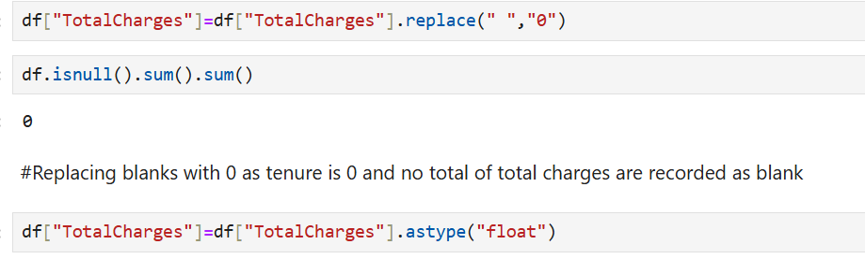
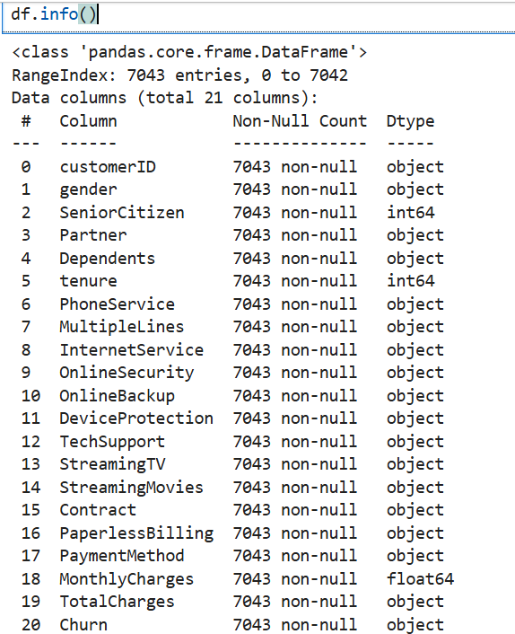
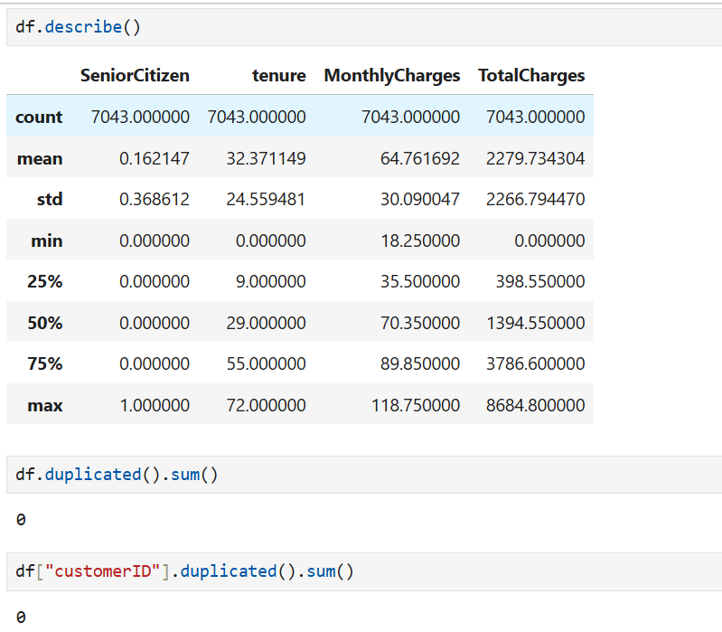
🔧 Data Preprocessing & Initial Exploration
To ensure the dataset was ready for analysis, I began by checking the data structure using .info() and .describe(). This gave an overview of the data types, ranges, and basic statistics for numerical columns. I then performed a thorough null value check, and fortunately, the dataset contained no missing values.
Next, I reviewed the distributions of categorical and numerical features to understand the data better and spot any irregularities. This step set the foundation for reliable visualizations and meaningful insights.

Slide 5
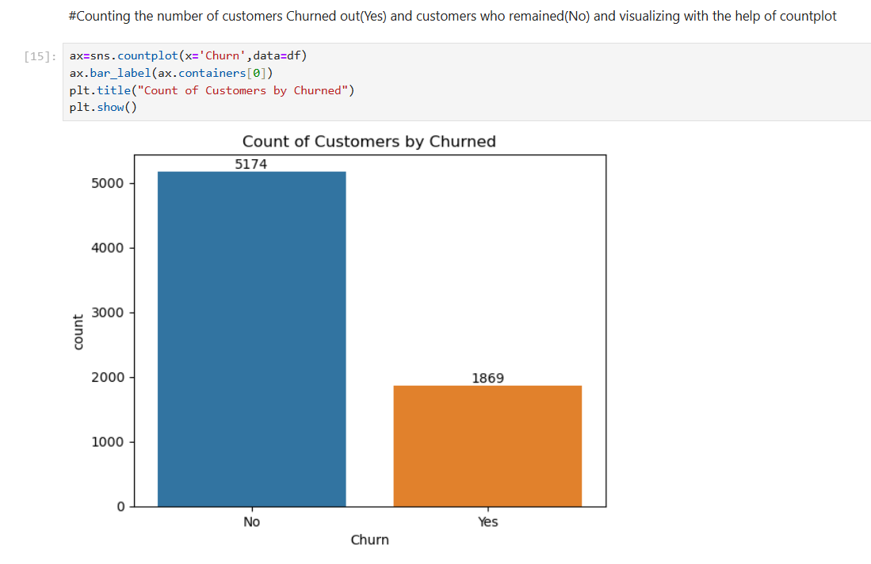
📊 Starting the DataAnalysis
📈 Customer Churn Distribution Analysis
To understand the basic distribution of customers who stayed and those who left, a countplot was used to visualize the Churn column.
Observation:
Out of all customers, 5,174 did not churn, while 1,869 customers did churn.
This shows that around 26.5% of customers left, indicating a significant churn problem worth deeper analysis
❓ Why Countplot Was Used:
Countplot is ideal for visualizing the frequency of categorical values, making it perfect for showing how many customers fall into the 'Yes' or 'No' churn categories.

Slide 6
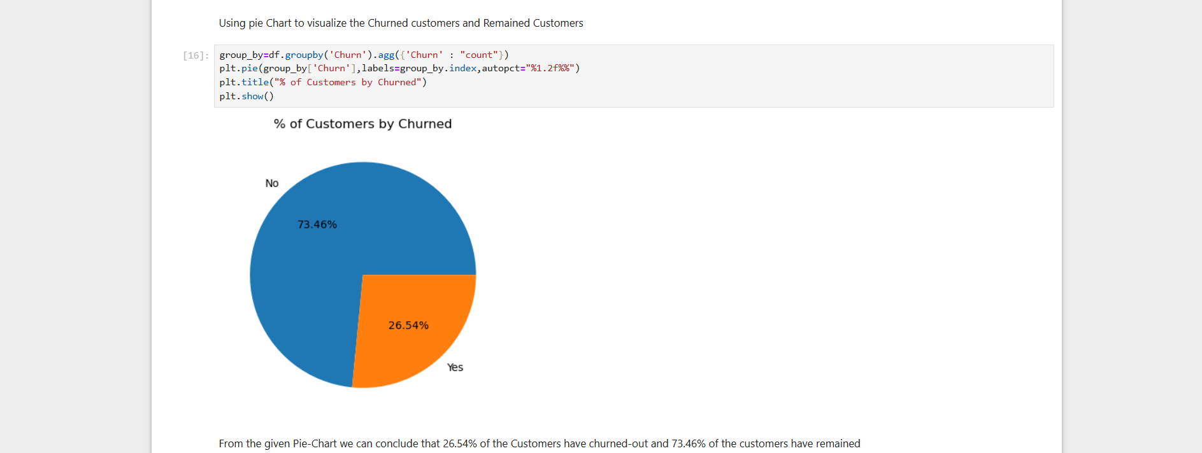
🥧 Customer Churn Percentage
The pie chart shows that 26.54% of customers have churned, while 73.46% have remained.
📌 Why Pie Chart Was Used:
Pie charts are ideal for showing proportions in a simple and visual way.
It clearly highlights the churn rate share compared to the whole customer base

Slide 7
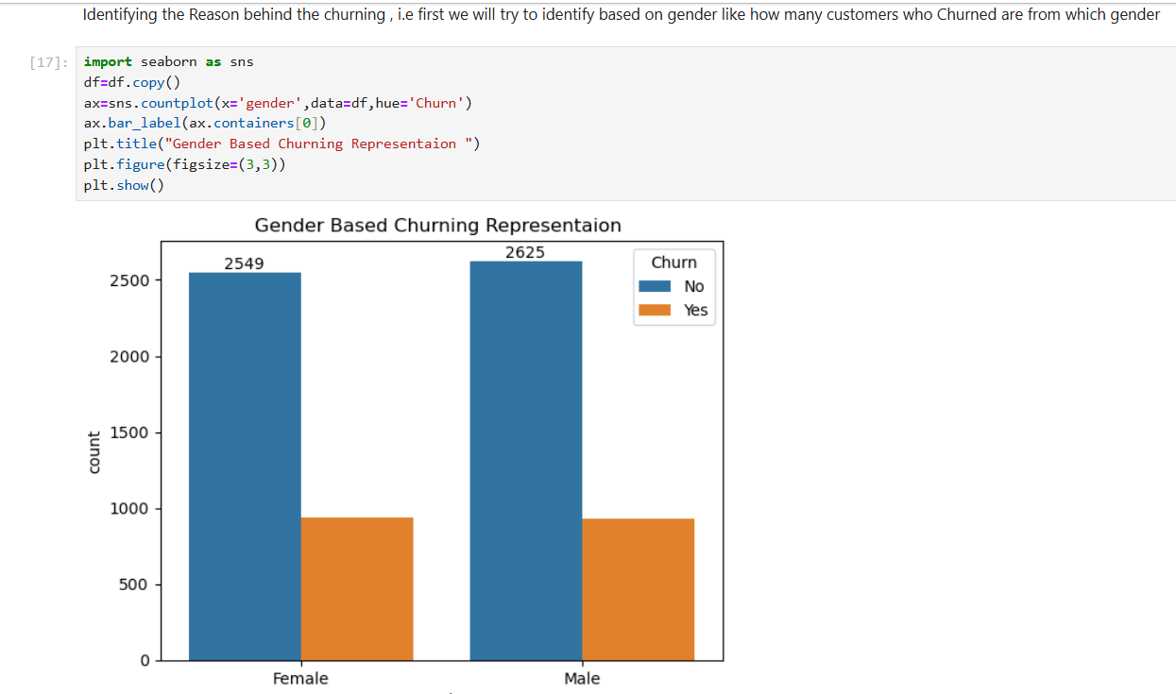
👥 Gender-Based Churn Analysis
This chart compares the number of male and female customers who churned versus those who stayed.
Observation:
Among female customers, around 2,549 stayed and 939 churned.
Among male customers, around 2,625 stayed and 930 churned.
The churn rates for both genders are nearly equal, suggesting that gender does not play a significant role in predicting customer churn.
This insight helps narrow down the analysis by confirming that other factors (like contract type, tenure, or payment method) may have more impact.
📌 Why Countplot Was Used:
Countplot is perfect for comparing multiple categories within a feature.
It allows us to visually distinguish churn patterns between male and female groups in one glance

Slide 8
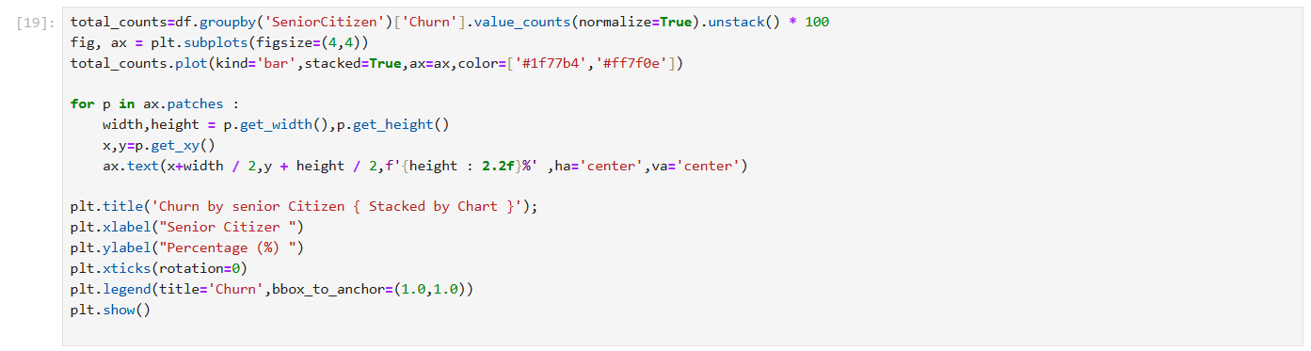
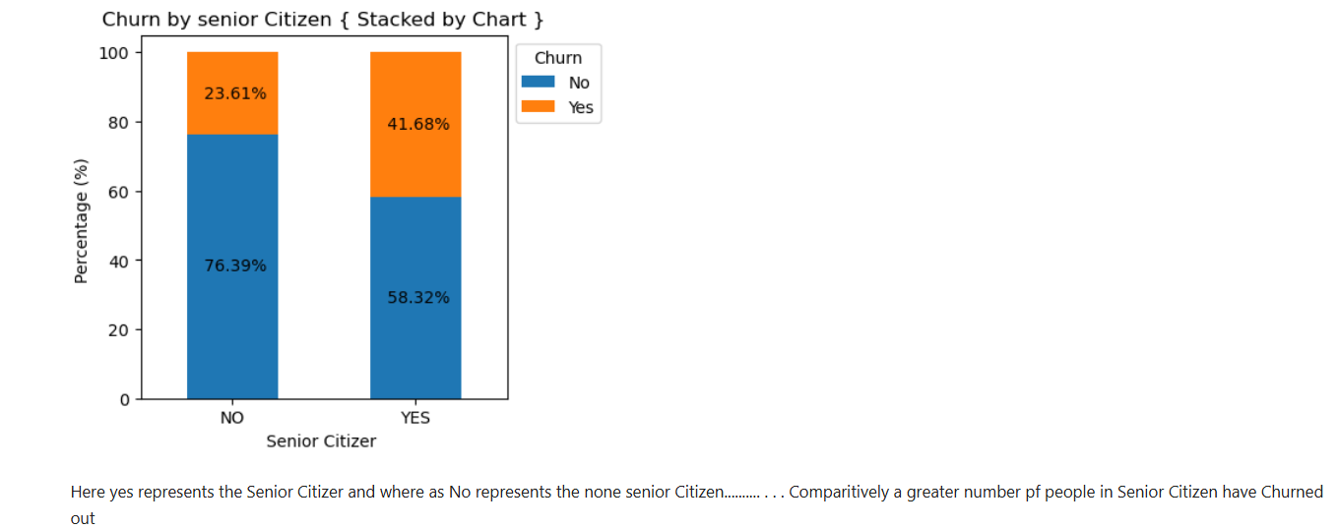
👴 Churn by Senior Citizen Status
Insight: 41.68% of senior citizens have churned compared to only 23.61% of non-senior citizens. → This shows senior citizens are more likely to leave the service.
📌 Why This Chart Was Used:
A stacked bar chart is effective to compare churn proportions within groups.
It clearly shows the churn percentage difference between senior and non-senior customers in one view.

Slide 9
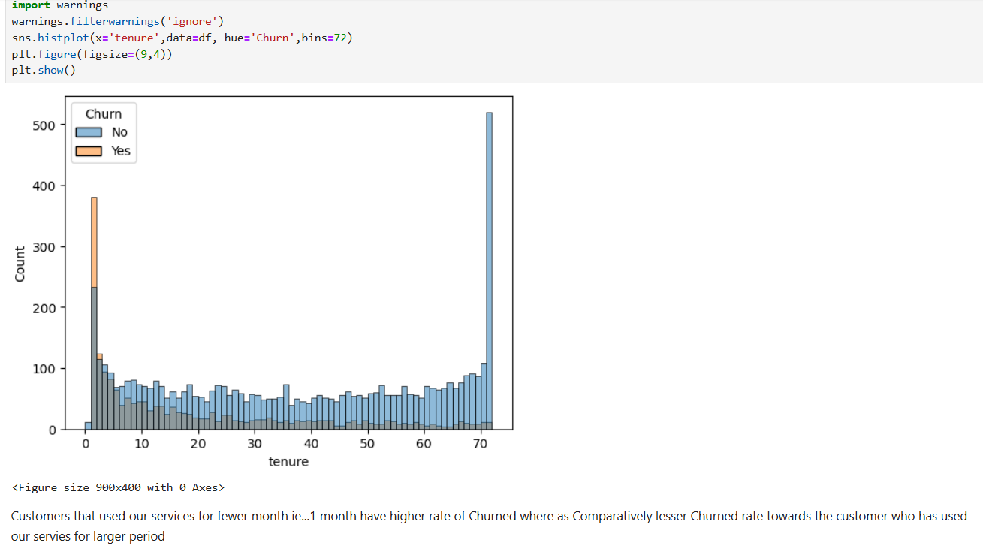
⏳ Churn Based on Tenure
Insight: Customers with very short tenure (especially 1–2 months) show a high churn rate, indicated by taller orange bars on the left. As tenure increases, the churn rate gradually decreases, and customers with longer service durations (60–72 months) are far less likely to churn. → This suggests that early-stage customer experience is critical in retention.
📌 Why a Histogram Was Used:
A histogram is ideal for showing the distribution of a continuous variable like tenure.
Using hue='Churn' allows us to compare churn vs non-churn across time in a single plot

Slide 10
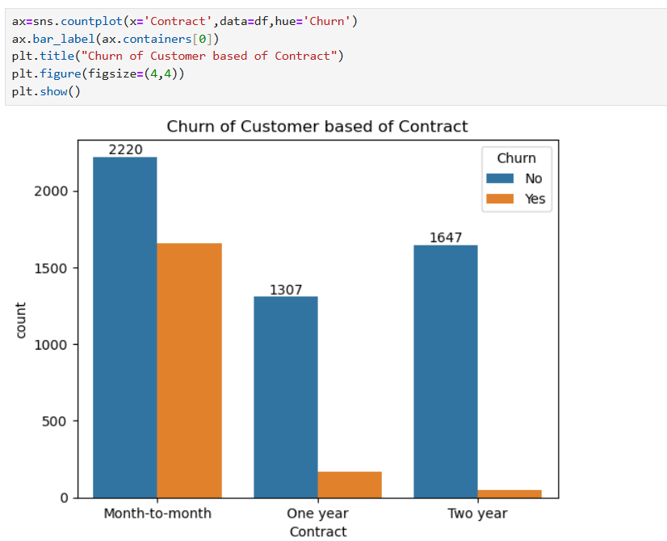
⏳ Churn Based on Contract
*Insight:*
The countplot reveals that customers with month-to-month contracts have the highest churn rate (1,307) compared to one-year contracts (1647). This suggests shorter-term commitments correlate with higher customer attrition, likely due to flexibility and lower switching barriers.
This suggests that short-term commitments lead to higher attrition* possibly due to: -
Lower switching barriers* (easy to cancel). -
Price sensitivity* (no long-term discounts). -
Flexibility-seeking behavior* (customers exploring alternatives).

Slide 11
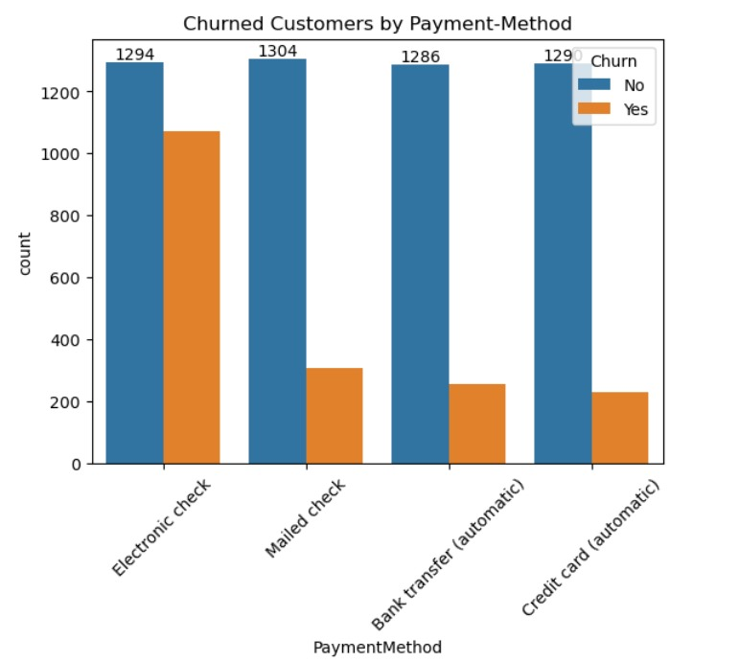
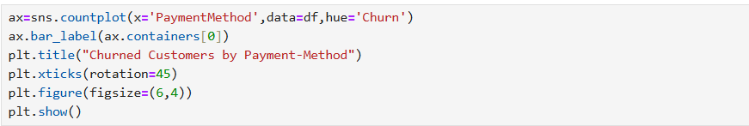
⏳ Churn Based on Payment-Method
*Insight:*
Customers using electronic checks show the highest churn (1,294), while automatic payment methods (bank transfer/credit card) have significantly lower churn. This suggests manual payment processes may frustrate customers, while automated options improve retention. Businesses should encourage automatic payments to reduce attrition.

Slide 12





Strategies for Customer Retention
Targeted Discounts
Offer 10-20% discounts to high-risk customers.
Customer Service
Enhance support experience for at-risk accounts.
Long-Term Contracts
Incentivize customers with extended contracts.
Loyalty Programs
Implement programs reducing churn by up to 5%.

Slide 13

Conclusion
This churn analysis reveals that approximately one in every four customers leaves the telecom service, with distinct trends explaining why. The most influential factors behind churn are contract length, tenure, monthly charges, payment method, and age group.
Notably, short-term and high-cost services result in higher churn, while long-term plans and automatic payments contribute significantly to customer retention. Additionally, new customers and senior citizens represent vulnerable segments that require tailored engagement strategies.
In conclusion, a data-driven customer retention strategy, rooted in understanding the behavioral and demographic patterns identified in this analysis, will be key to reducing churn and increasing lifetime value.

